Slide 1


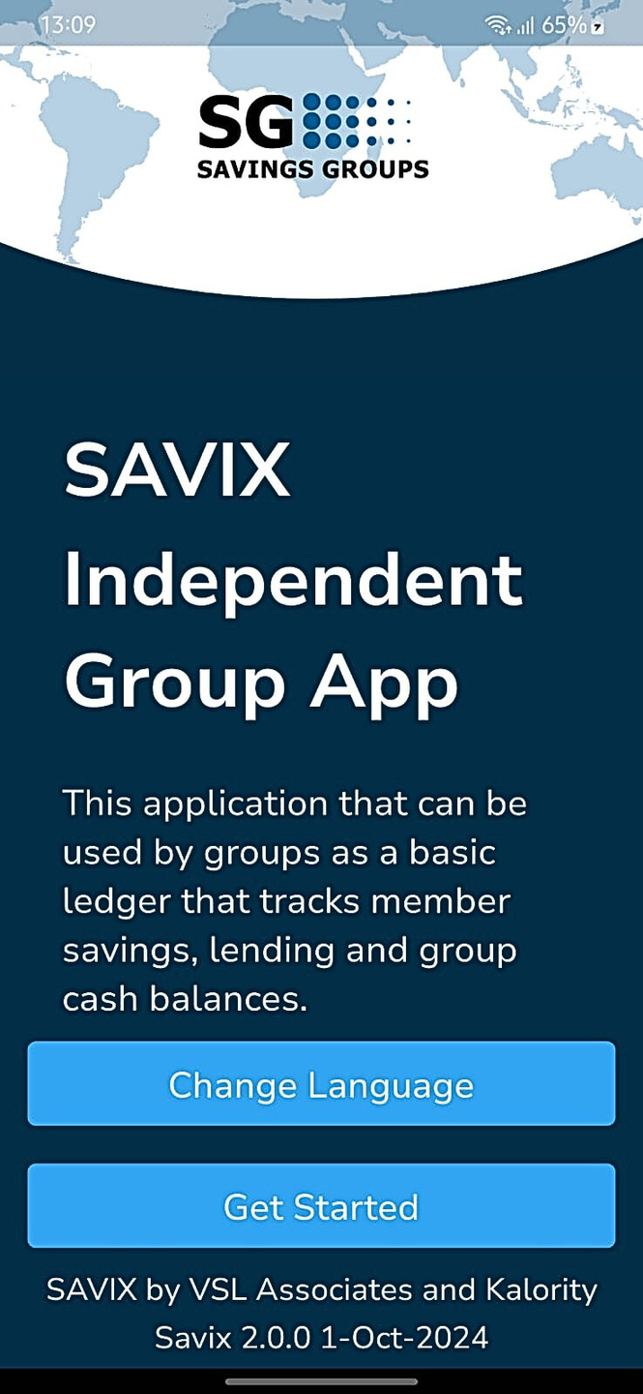

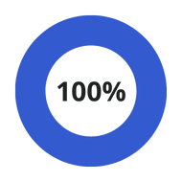
KALORITY
SAVIX
INDEPENDENT GROUP APP
Efficient
User Friendly

Slide 2

KALORITY
Welcome To Our Application
About Our Application
With the help of Kalority LTD, VSLA has come up with the Independent group app allowing independent groups to be able to collect data as well as carry out complex calculations during shareout and loan repayment. Groups also have the option to take a back up of their data which can be restored at any time incase of loss or damage to their mobile phone.
Powered by Kalority LTD

Slide 3
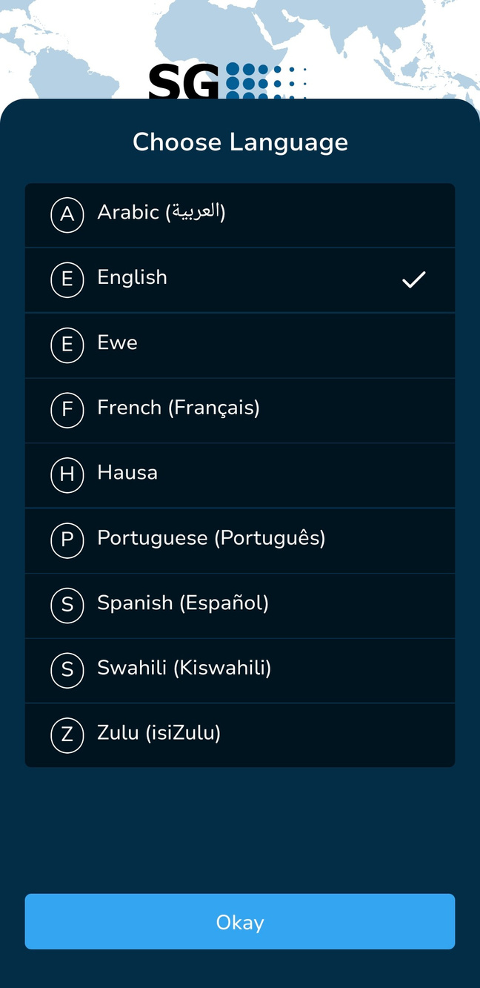
KALORITY
Application Advantages
Cloud Backup
Group Financial Report
01
02
member Report shared through SMS
Complex share-out calculations made easy
03
04
Social Fund Activities tracking
Translated in 9 languages
06
05

Slide 4
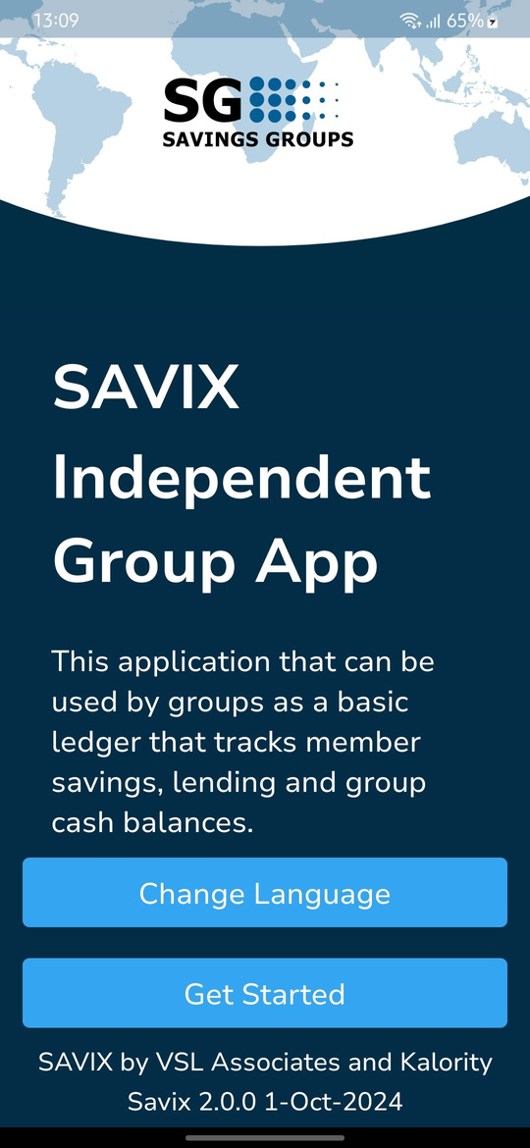
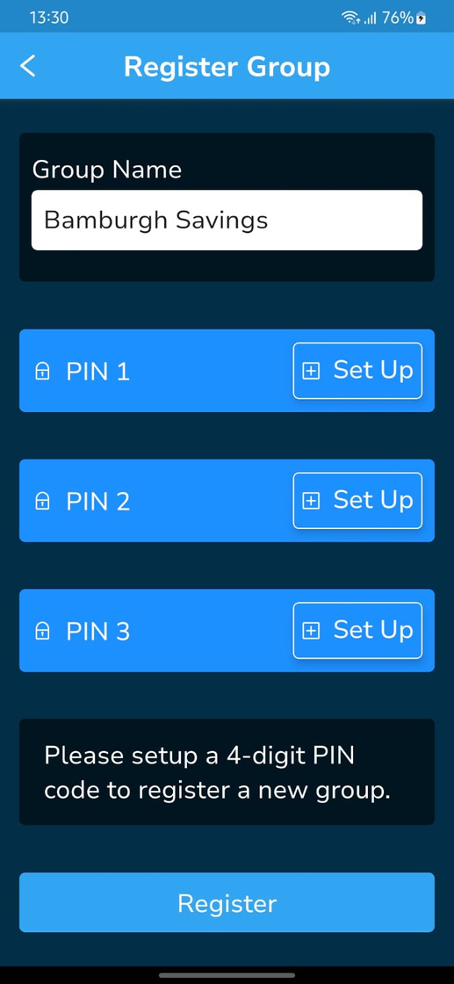
Register Group
KALORITY
To register a group, you need:
A group name and 3 different pins known by 3 different group members (usually these are not members of the Manhagement Committee). With each pin known to only one person.

Slide 5
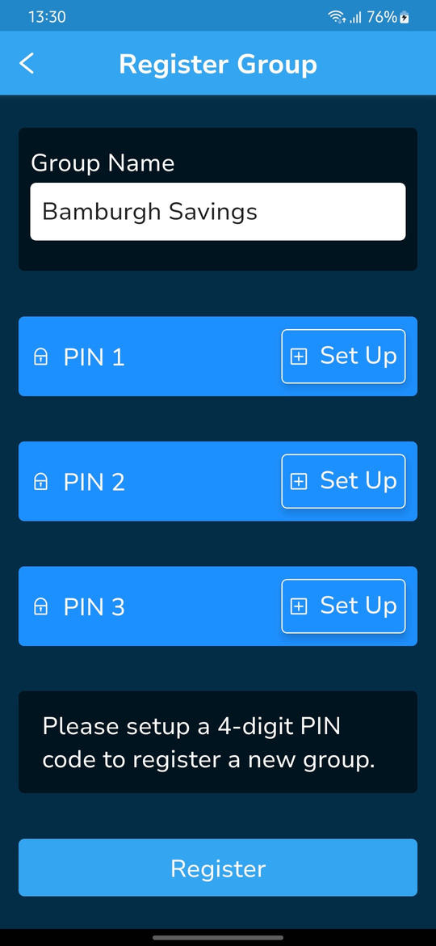
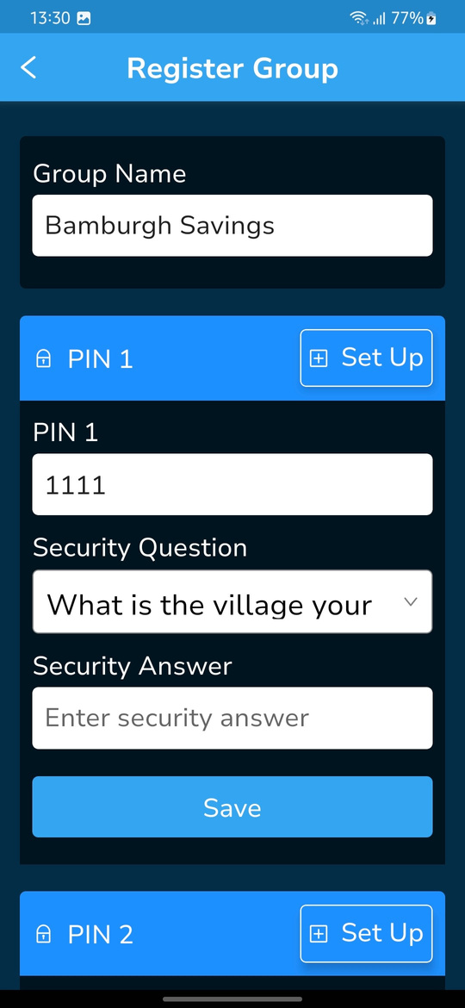

Register Group: Pin Set Up
KALORITY
To set up a pin,
Click on the ‘Set up’ button. This will reveal three fields.
Enter a 4 digit pin and select a security question from the drop down.
Enter the answer to the Security question in the ‘Security Answer’ field.
Click ‘Save’. This will complete the set up for a pin, proceed with the same process for the rest of the pins not yet set up.
Once all pins have been set up, click ‘Register’ this will redirect to the login screen.

Slide 6
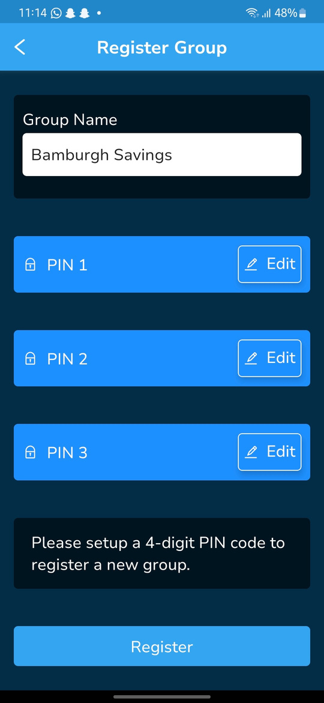
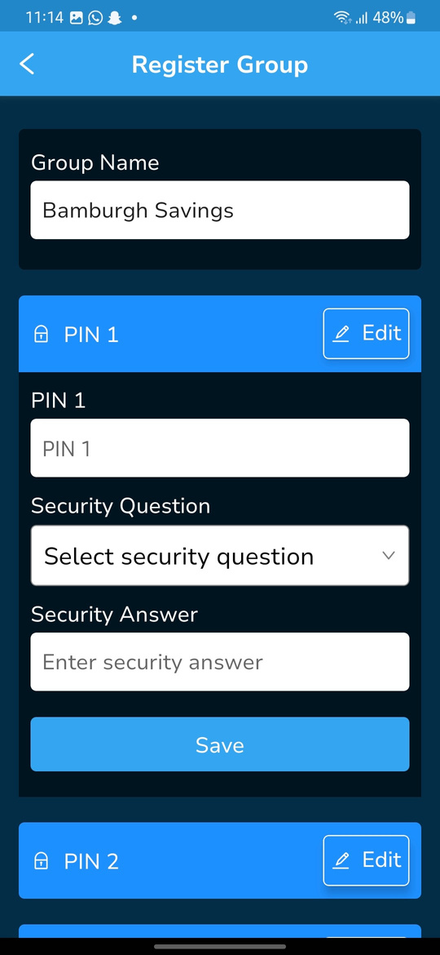
Register Group: Edit Pins
KALORITY
To edit a pin,
Click on the ‘Edit’ button. This will reveal three fields. The previously entered pin and security question will be cleared.
Enter a 4 digit pin and select a security question from the drop down.
Enter the answer to the Security question in the ‘Security Answer’ field.
Click ‘Save’. This will complete the editing and save new pin.
Once you’re done editing, click ‘Register’ to complete group registration and be redirected to the login page.

Slide 7
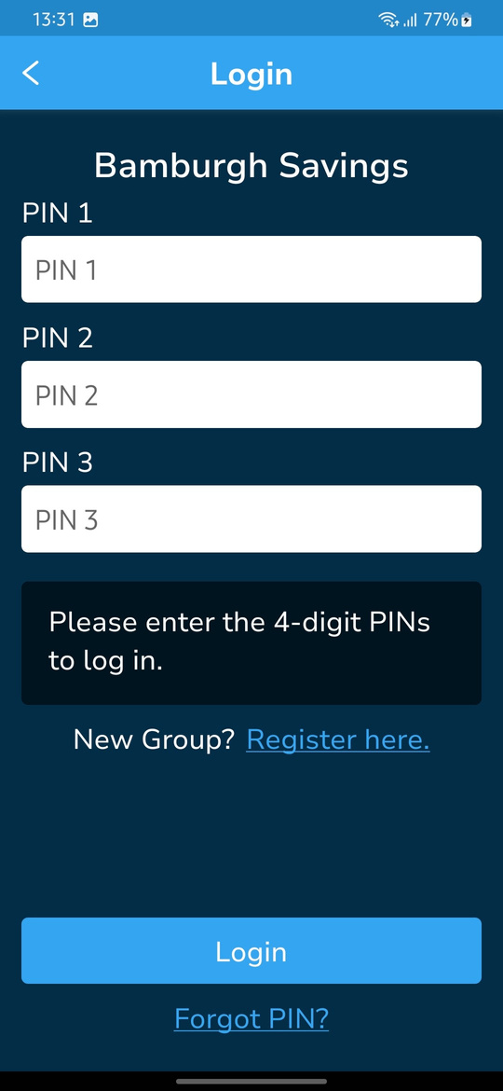
Group Login
KALORITY
Once a group is registered on the app, the group can login using the three pins set up during registration and clicking ‘Login’. This will redirect to Group Configuration screen.
If a pin is forgotten, it can be reset by clicking ‘Forgot Pin’. Next slides show the pin reset process.

Slide 8
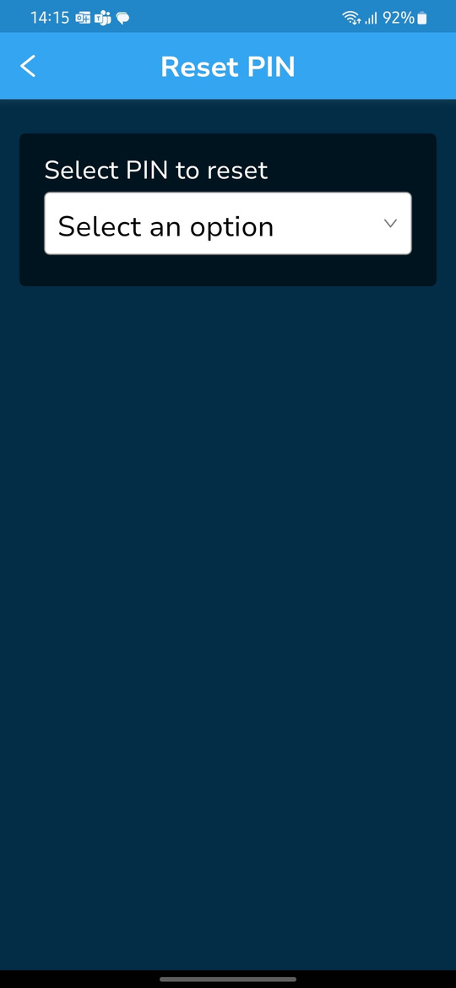

Forgot Pin: Pin Reset
KALORITY
STEP 2: Click on the drop down to select the pin to be reset.
STEP 1: Click ‘Forgot Pin’, this will redirect to the reset pin screen.

Slide 9
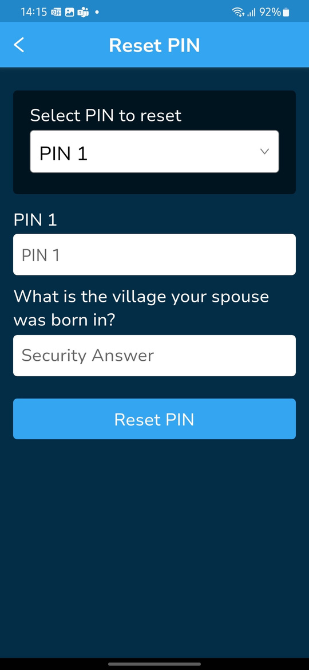
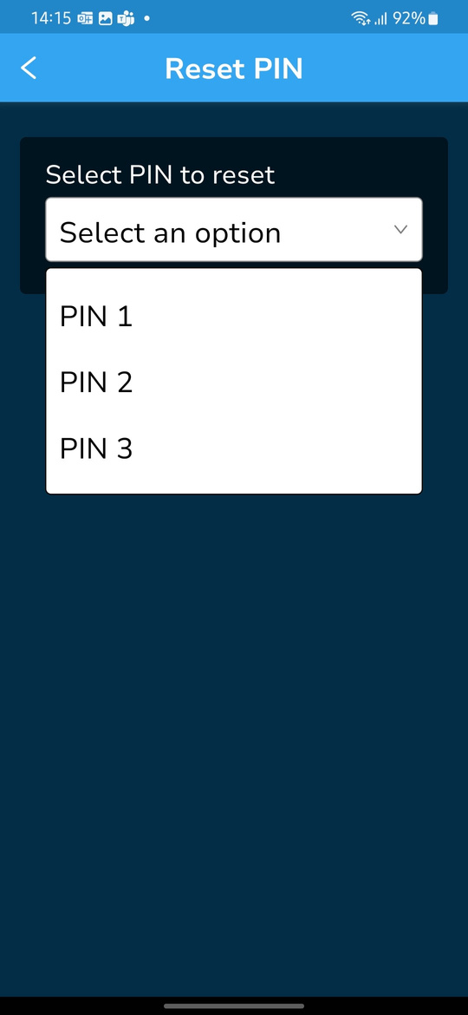
KALORITY
Forgot Pin: Pin Reset
STEP 3: Select the pin you wish to reset .
STEP 4: Enter new pin and answer to the security question selected during pin set up, then click ‘Reset Pin’.

Slide 10
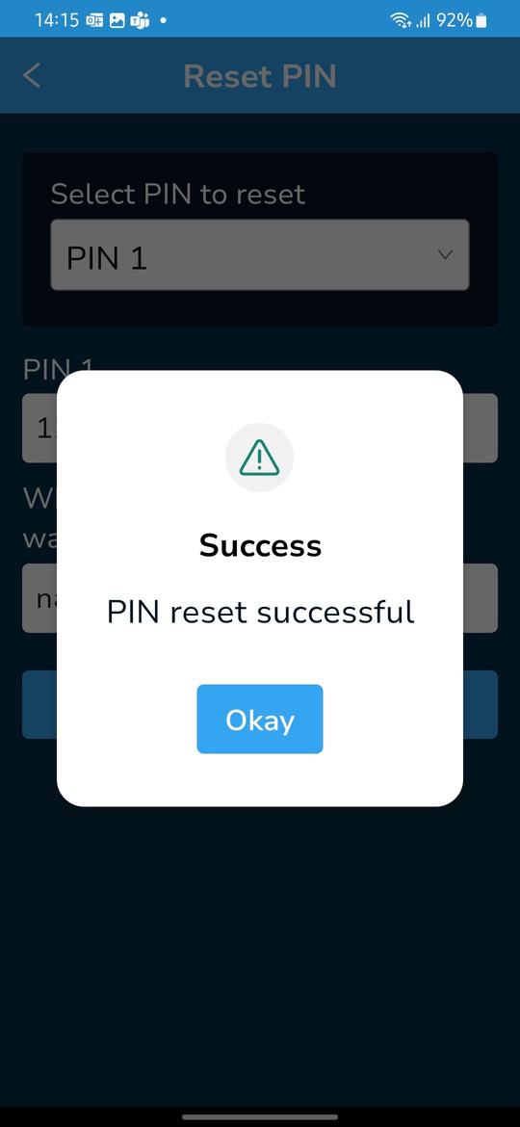
Forgot Pin: Pin Reset
KALORITY
STEP 5: Select ‘Okay’ to proceed to the ‘Login’ screen
STEP 6: Use the new pin to login. The other pins remain unchanged.

Slide 11
Group Configuration
KALORITY
For a newly registered group, this is the first step once they login. Here, a group defines the rules and policies of the group.
Country Information - The country in which the group operates. This also determines the currency they use and the smallest amount in everyday use
Cycle - This defines the savings cycle that the group is in, for old groups it is greater than 1
Social Fund - Does the group have a Social Fund,? How much is the Social Fund contribution per member?
How members save - Does the group record the cash value of individual savings or does it record the number of shares each member buys?
Savings to Loan Ratio - Is there a link between a member’s savings and the amount that can be borrowed. If there is, how many times the value of a member’s savings is the maximum that can be borrowed?
Cost of Borrowing - This allows the group to charge interest on loans every 28 days (month/4 weeks). They can charge i) a percentage on the balance after repayment (Declining Balance) ii) a constant amount every 4 weeks (monthly) equal to a percentage of the principal amount (Flat Interest) or iii) a Fixed Amount agreed upon by the group when the loan is being issued that is added to the principal sum (Fixed Amount) and is not increased every 4 weeks
Bank - Here the group can select ‘Yes’ if they have a group bank account otherwise ‘No’.
02

Slide 12
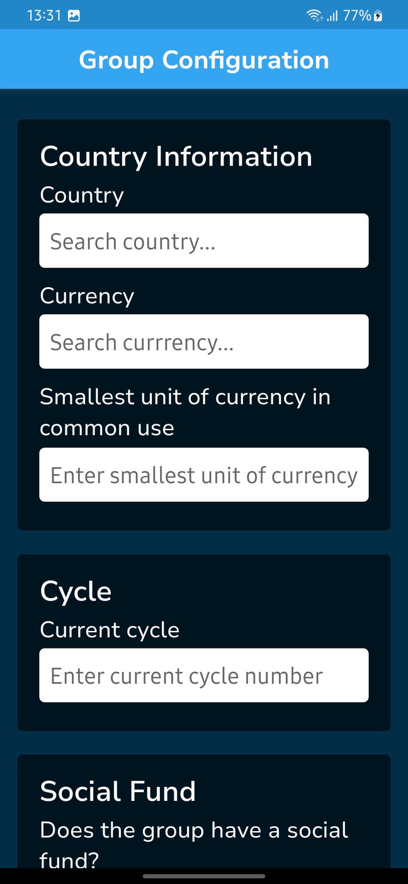
Group Configuration
KALORITY
Country information
Country: - can be typed in and selected based on the result that closely matches the words typed in.
Currency - can be typed in and selected based on the result that closely matches the words typed in.
Smallest Unit of Currency - this is the smallest amount of money that commonly used in a certain country or region.
Cycle
Current Cycle - This should be a number greater or equal to 1, depending on how long the group has been existence i.e. how many savings cycles it has gone through complete with share-out.
02

Slide 13
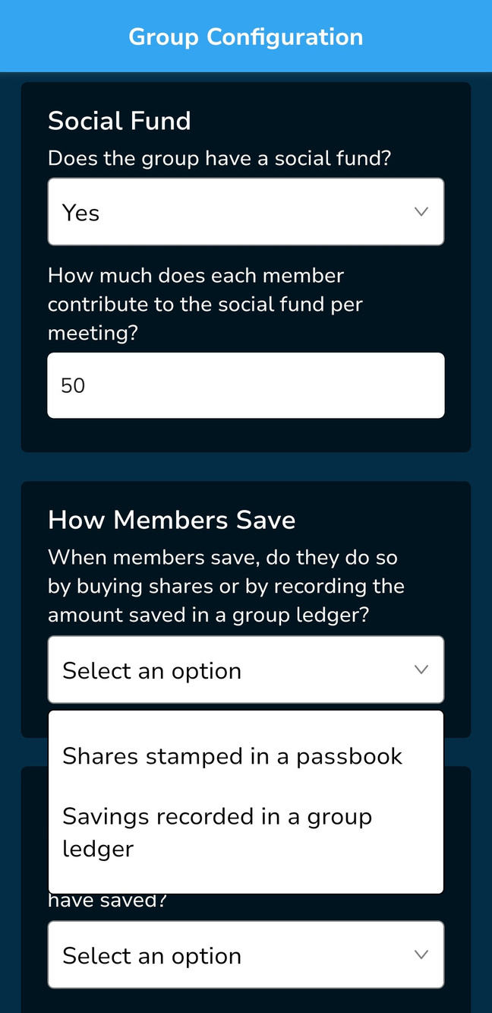
Group Configuration
KALORITY
Social Fund - It is not mandatory. The group decides if it wants to have one or not. Individual member contributions are recorded if the group has a Social Fund. The minimum contribution amount at each meeting is specified here.
How members save. There are two choices.
Shares bought– Number of shares bought at each meeting, recorded in each member’s passbook
Cash value of savings, shown as a cash amount recorded in a group ledger
02

Slide 14
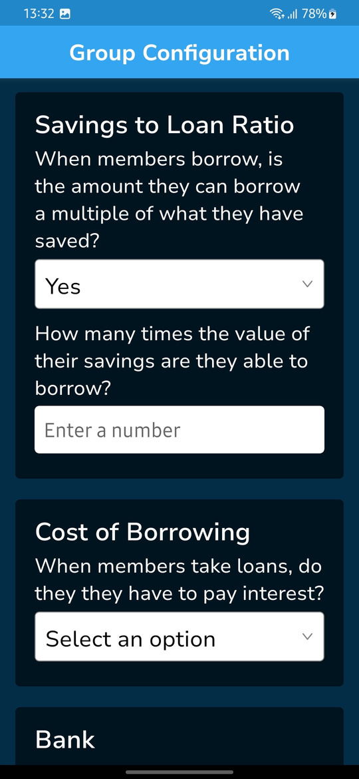
Group Configuration
KALORITY
Savings to loan ratio
Most SGs allow members to borrow more than they have saved, but usually put a limit on this. The group can select how many times the value of a member’s savings they can borrow. In this case a member can borrow up to 3 times the value of their savings.
02

Slide 15
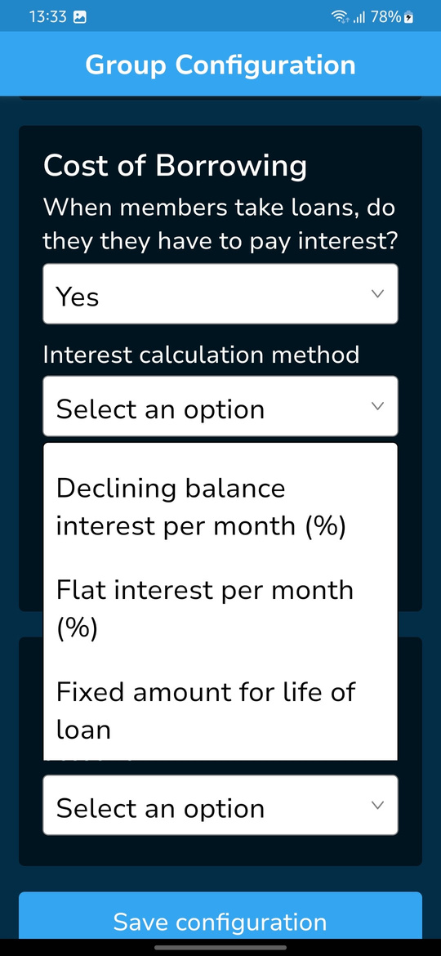
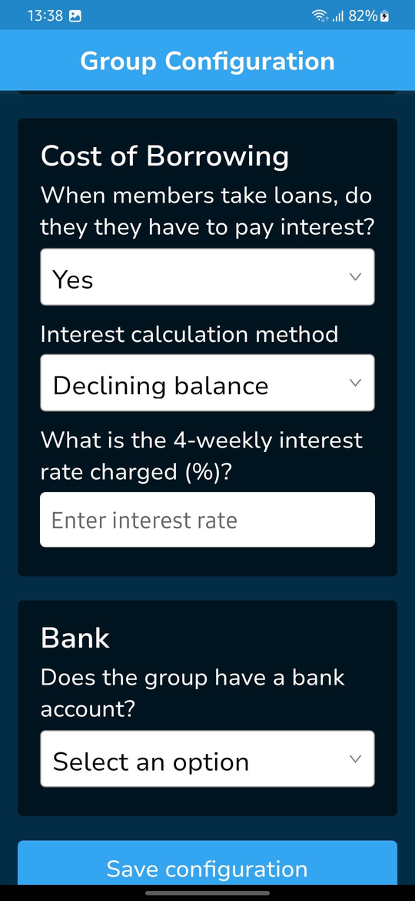
Group Configuration
KALORITY
Cost of Borrowing - Specifies whether a loan taken accrues an interest or not and the rate of interest if it does.
Interest calculation methods:
Declining Balance
Flat Interest
Fixed amount
4 weekly interest charge (enter interest rate). The percentage charged on either flat interest or declining balance loans every 28 days, until the loan is repaid in full.
02

Slide 16
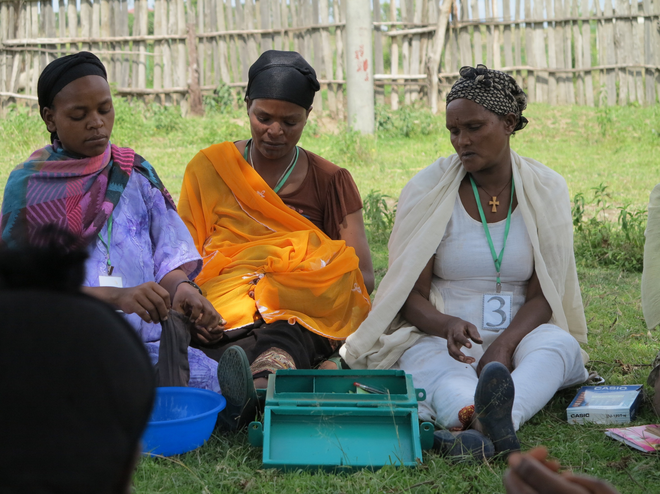

KALORITY
Interest Calculation Methods Explained
KALORITY
Declining Balance
Flat Interest
Fixed Amount
The interest is calculated as a percentage of the amount left after a repayment is made and is adjusted every 28 days (4 weeks)
The interest is calculated as a percentage of the initial amount borrowed, and the same amount is charged every 28 days, regardless of the loan balance
The Interest/service charge is an amount, decided by whatever method the group decides. This is added to the value of the loan, one time only. The total is then paid back, without any new charges being added et any time theafter
02

Slide 17
Group Configuration
KALORITY
Bank - The Group declares if it has a bank account.
Save Configuration – For the configurations to take effect, the user clicks on the button.
Note - if a group does not have a Social Fund or a bank account, the data entry screens will not show these fields in the cash balances section or in ending reports
02

Slide 18
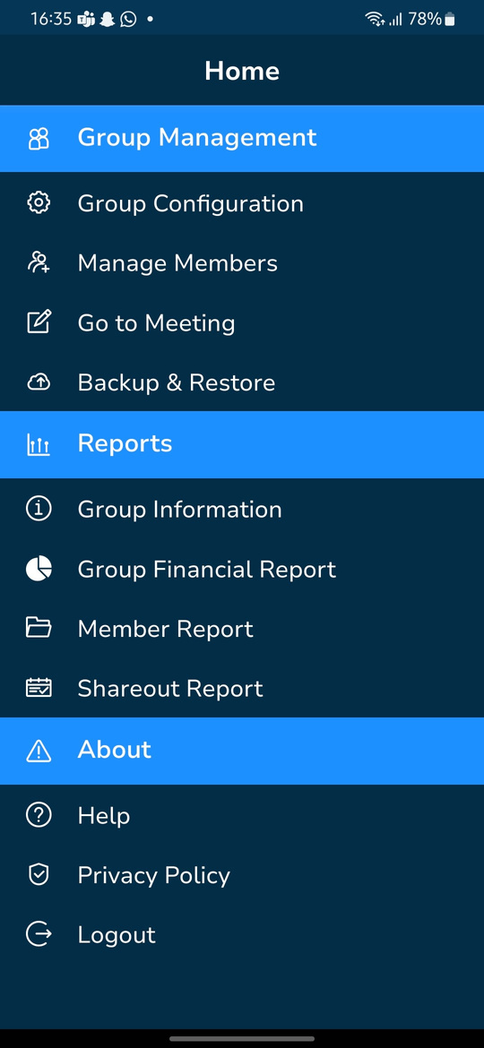
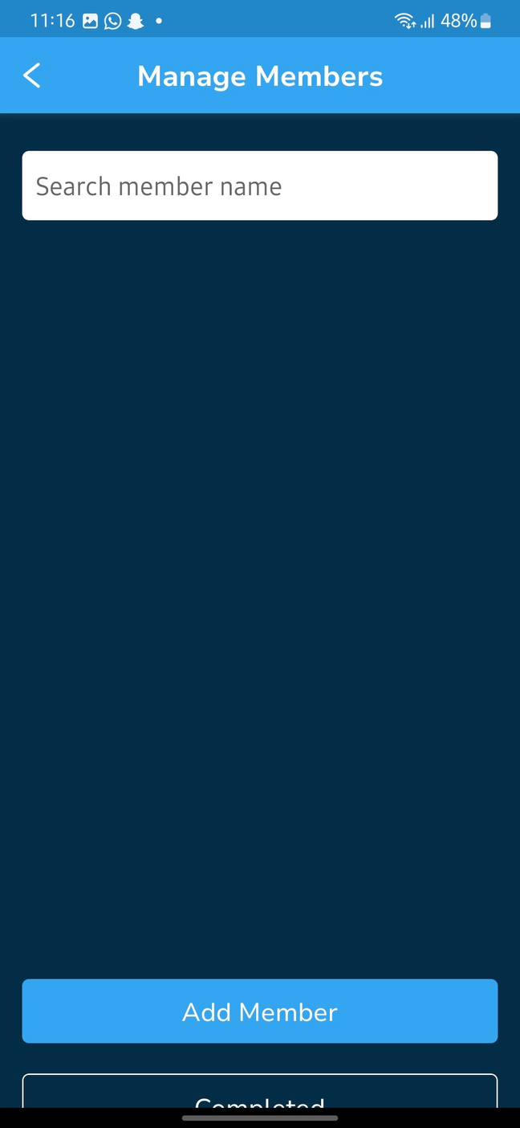

member Management: Add new member
KALORITY
STEP 1: From the home page, select ‘Manage members’
STEP 2: Select ‘Add member’ To add a new member.

Slide 19
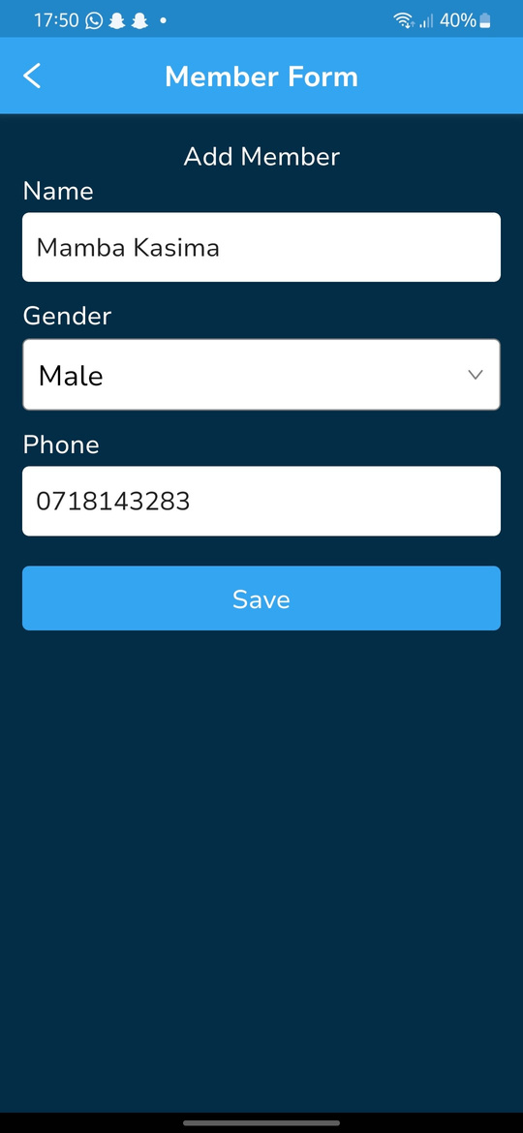
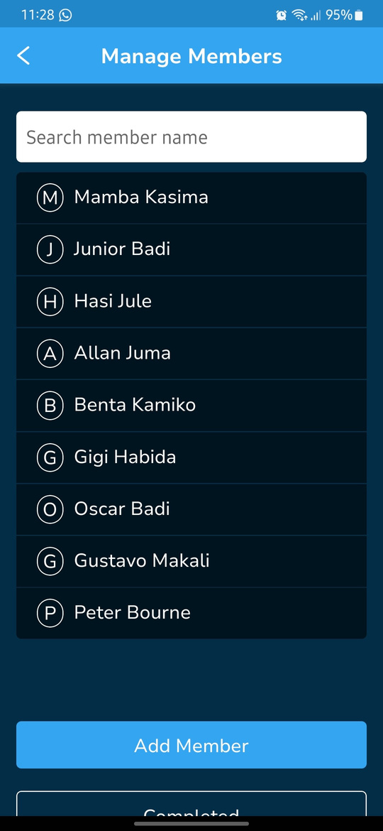
member Management: Add new member
KALORITY
STEP 3: Fill in the ‘Add member’ form with the details requested, then click ‘Save’.
STEP 4: New member has been added to the member list.
members are added one at a time.

Slide 20
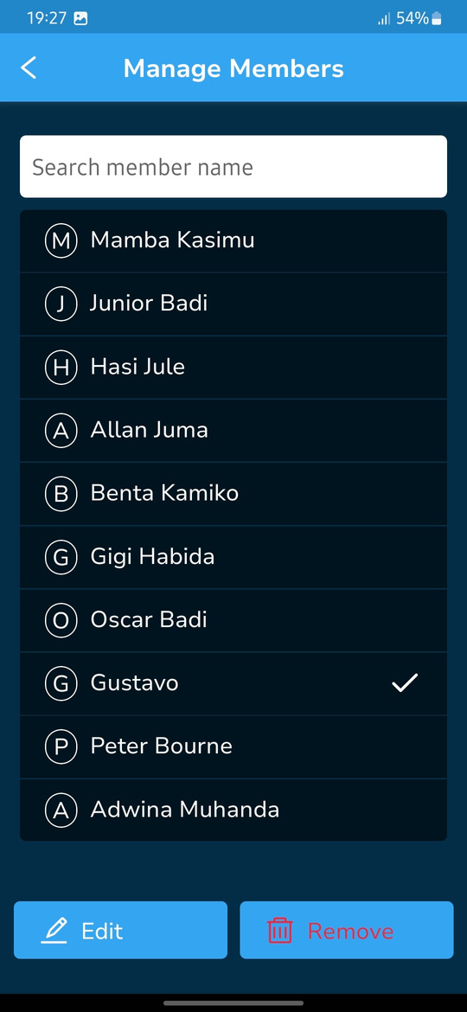
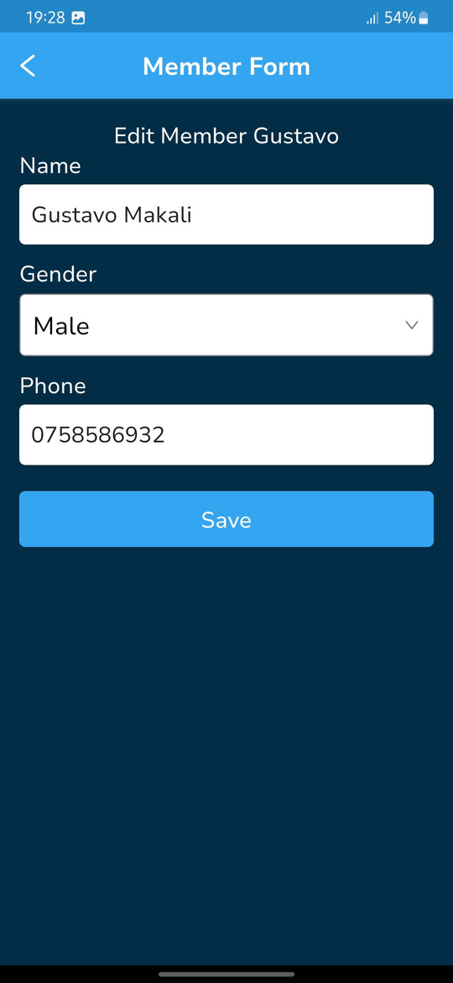
member Management: Edit member
KALORITY
STEP 1: Select member you wish to edit from list. A checkmark, an ‘Edit’ button and a ‘Remove’ button will be revealed. Select ‘Edit’
STEP 2: Edit member name, gender or phone number.

Slide 21
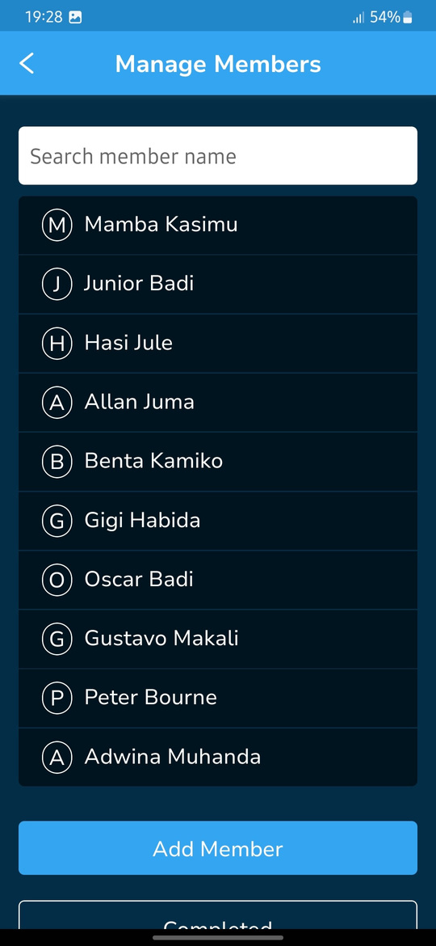
member Management: Edit member
KALORITY
STEP 3: Click save after all the edits are done.
STEP 4: The member name has changed on the list.

Slide 22
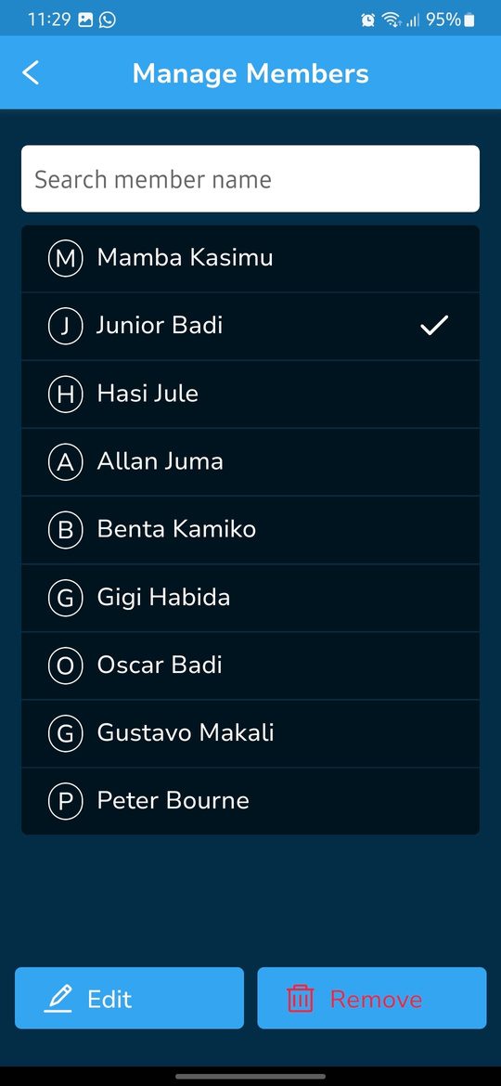
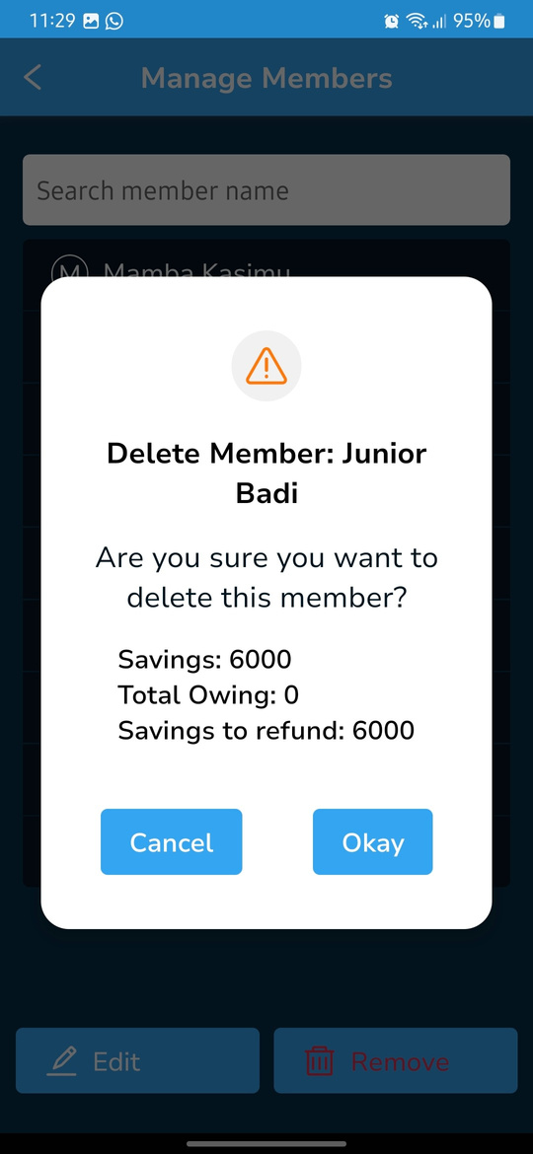

KALORITY
member Management: Delete a member with Savings only
STEP 1: Select member you wish to remove from list. A checkmark, an ‘Edit’ button and a ‘Remove’ button appear. Select ‘Remove’
STEP 2: From the pop up, the member has no loan balance, hence they are eligible for payment from the group upon deletion.

Slide 23
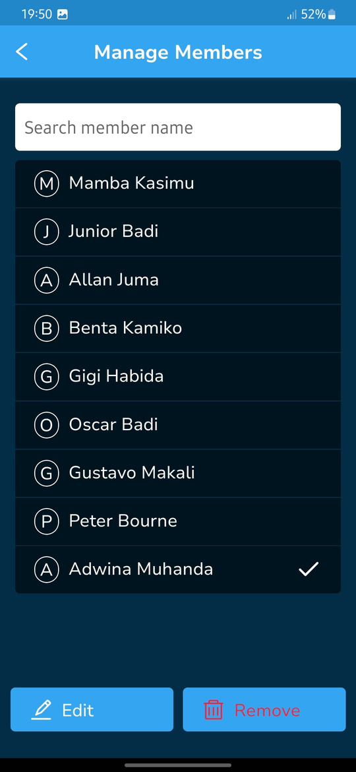
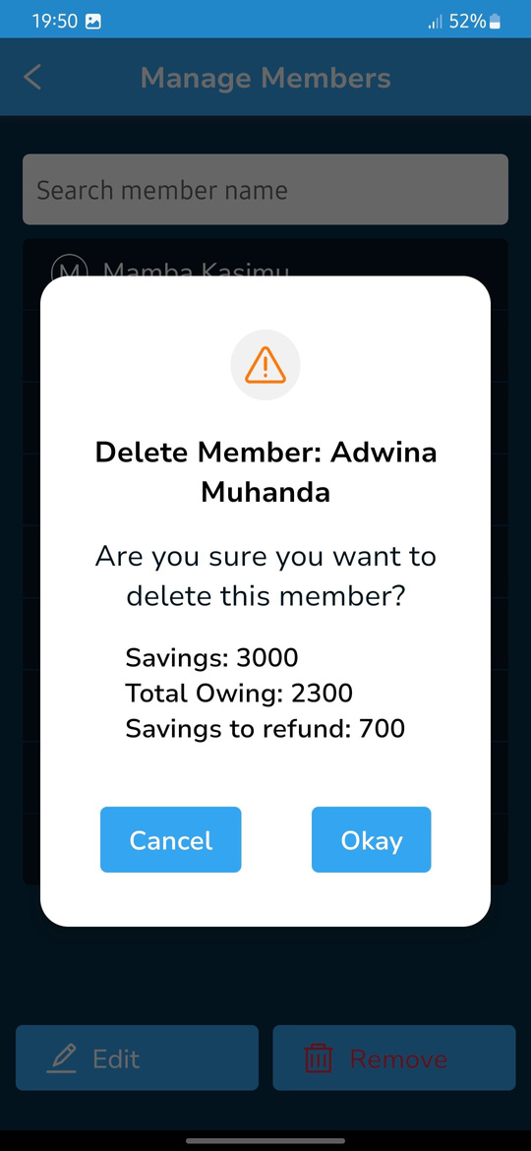
member Management: Delete a member with more Savings than Loan
KALORITY
STEP 1: Select member you wish to remove from list. A checkmark, an ‘Edit’ button and a ‘Remove’ button appear. Select ‘Remove’
STEP 2: From the pop up, the member has a loan balance that will be deducted from their savings upon deletion, after which the group owes them 700 from the left over savings.

Slide 24
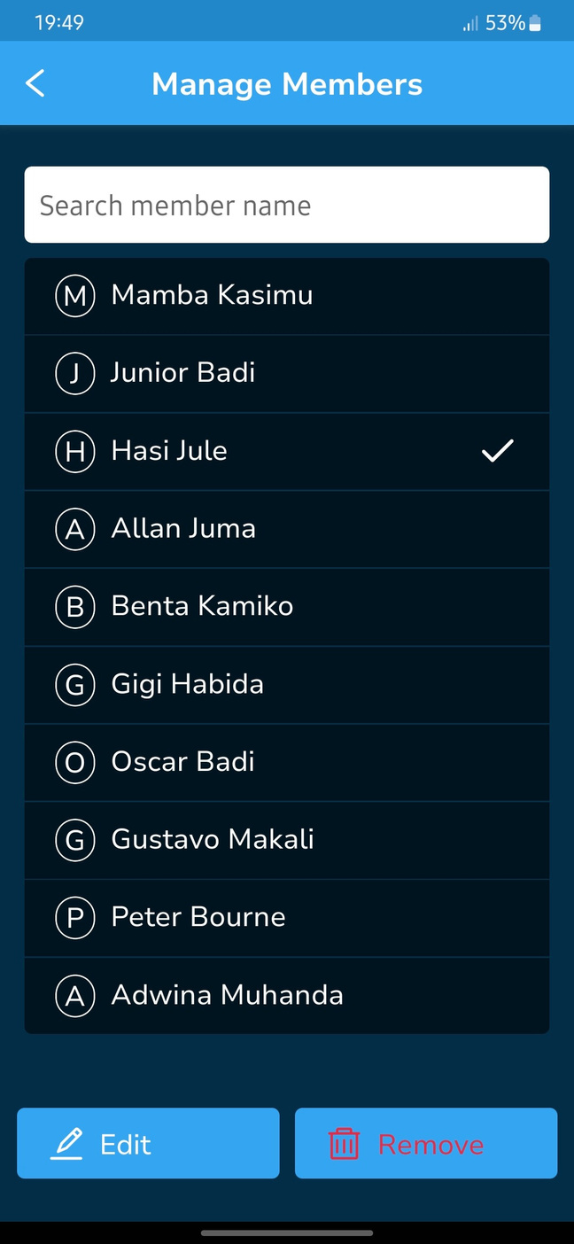
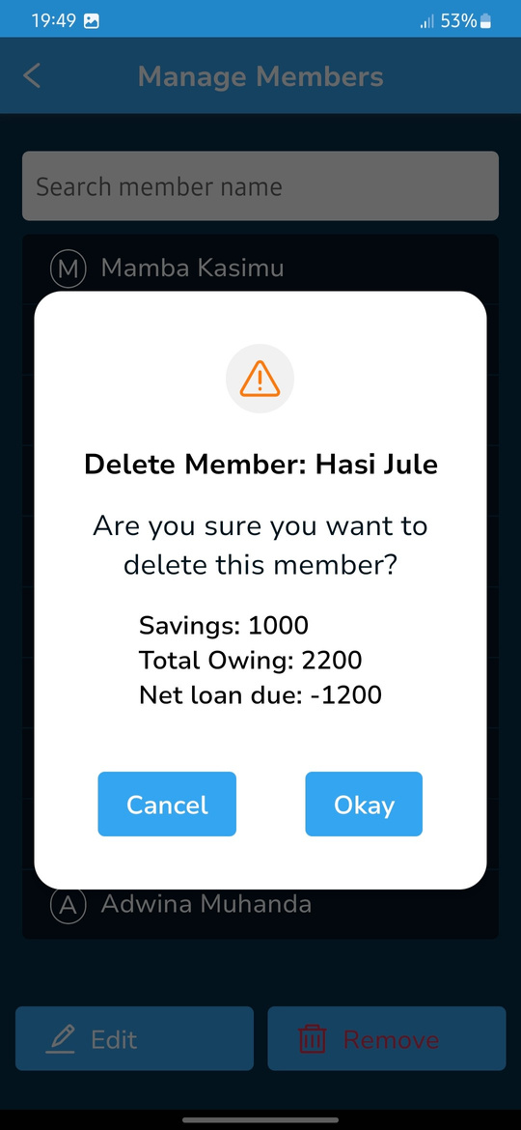

member Management: Delete a member with Less Savings than Loan
KALORITY
STEP 1: Select member you wish to remove from list. A checkmark, an ‘Edit’ button and a ‘Remove’ button appear. Select ‘Remove’
STEP 2: From the pop up, You can see that the member had a loan balance that was more than their savings. They owe the group 1200 upon their deletion.

Slide 25
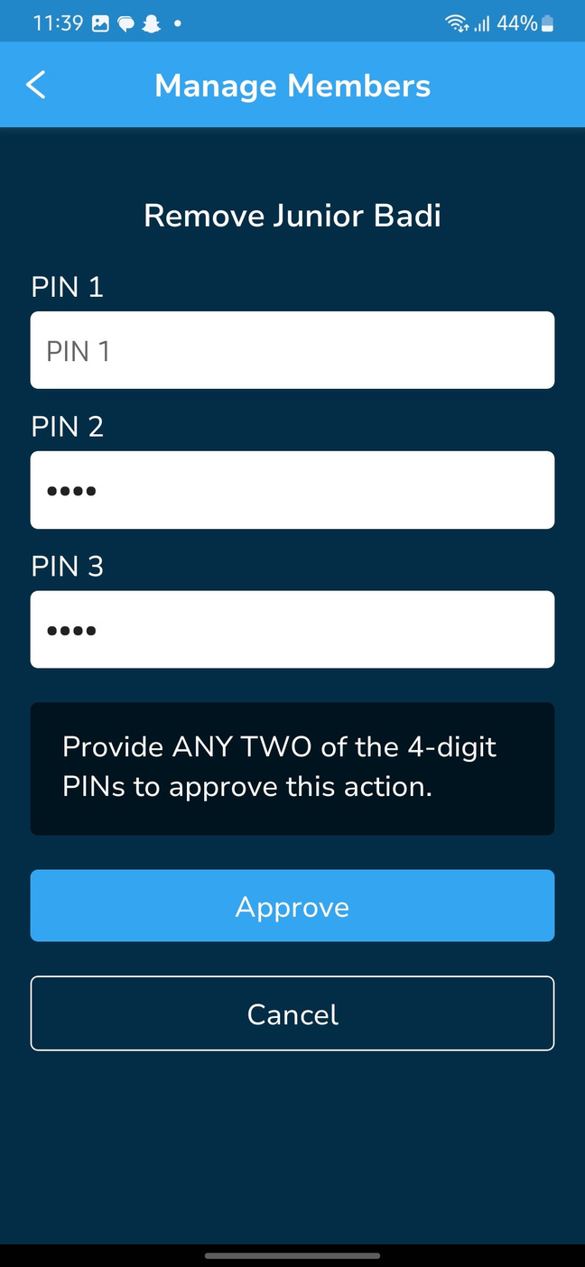
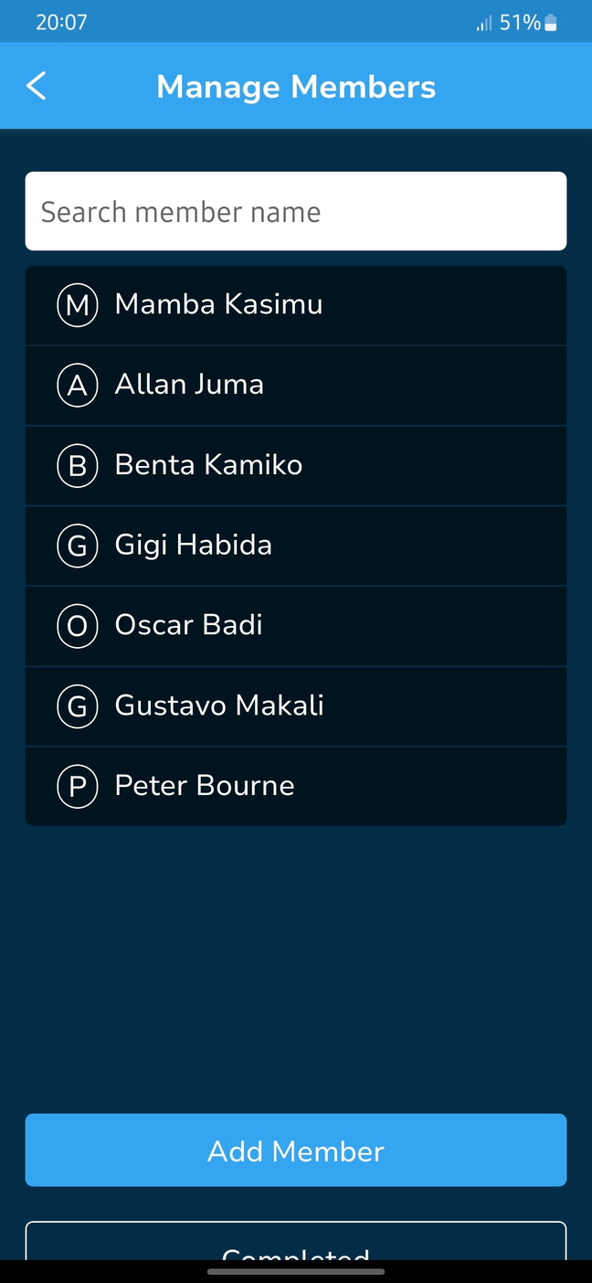
member Management: Delete a member
KALORITY
STEP 4: Once removal is approved, confirm that the member no longer exists on the list.
STEP 3: Input any 2 pins to authorize deletion then click ‘Approve’ to complete.
members can only be removed one at a time.
You can stop the removal at this stage by clicking ‘Cancel’

Slide 26
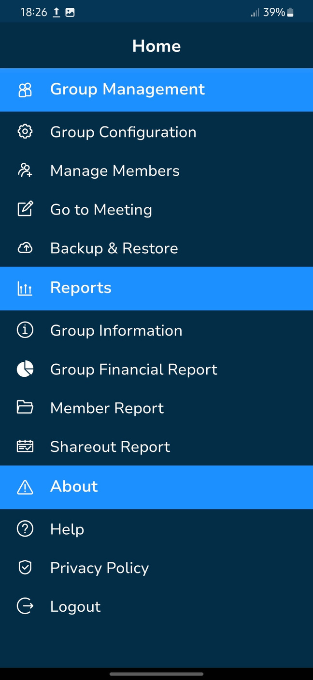
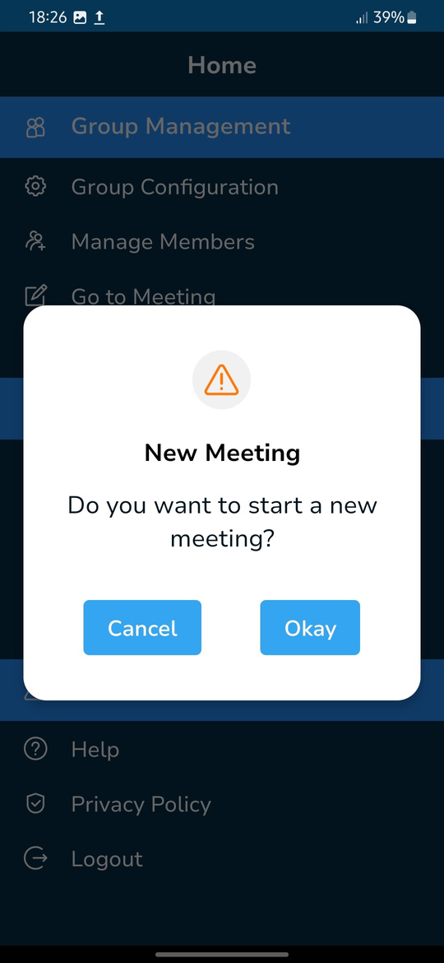

KALORITY
Go To Meeting
STEP 1: From the home page, select ‘Go to Meeting’
STEP 2: On the pop up, select ‘Okay’ to start a meeting or ‘Cancel’ to go back to the home page.

Slide 27
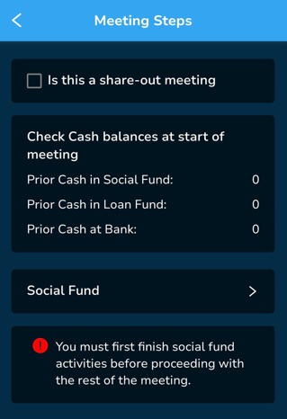
Meeting Steps
KALORITY
‘Is this a share-out meeting’ - This checkmark should only be selected if the group has come to the end of their cycle and are ready to distribute either part or all of the money accrued during the cycle. Most if not all loans should be cleared prior to the meeting .
Check Cash balances at the start of meeting - These values are as a result of data saved in the previous meeting displayed here to ensure starting balances can be validated through counting cash or by study of bank statements.
Social Fund - This opens a series of screens to help the group manage their Social Fund as well as track the contributions, loans and grants given from the Social Fund. This must be done at the start of a new meeting.

Slide 28
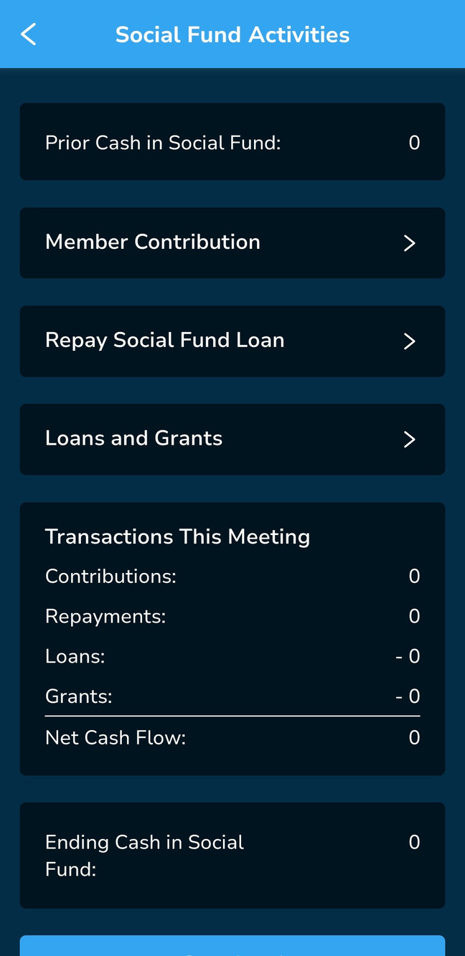
Meeting Steps: Social Fund Activities
KALORITY
Prior Cash in Social Fund - This will show the value recorded for Cash in Social Fund from the last meeting.
member Contribution - where the record keeper will manage member contributions.
Repay Social Fund Loan - For any loans given from the Social Fund, repayments will be tracked here.
Loans and Grants - Any loans or grants to be given are first recorded here by the record keeper.
Transactions in Meeting - This gives a summary of all the transactions done in the Social fund activities. (contributions, loan repayments, loans disbursed and grants issued).
Ending Cash in Social Fund - This value will be calculated based on the transactions done in the Social Fund Activites.

Slide 29
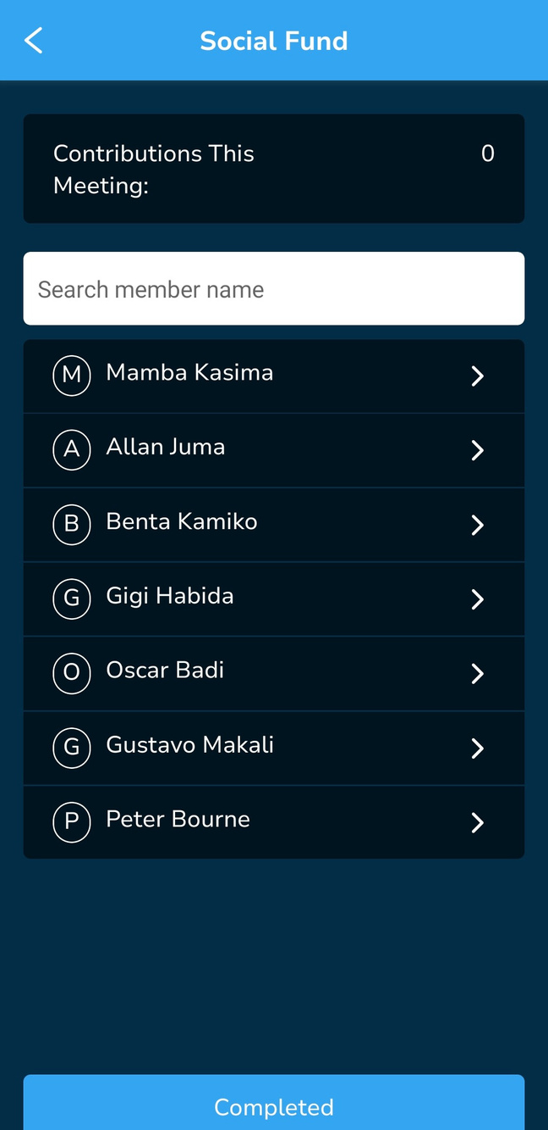
Social Fund Activities: member Contribution
KALORITY
The record keeper will select individual members from the list to record and save their contribution amount.

Slide 30
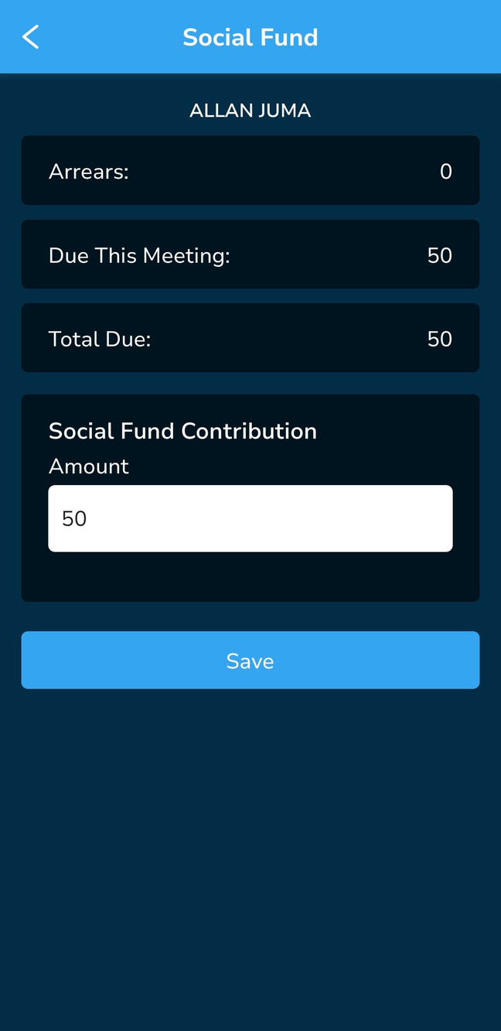
Social Fund Activities: member Contribution
KALORITY
For every member selected, the following will be shown:
Arrears - Any Social Fund contribution they have not paid
Due This Meeting - the Social Fund contribution amount to be paid in that meeting.
Total Due - This is the sum of arrears + amount due this meeting.
Social Fund Contribution - This is where the value of their actual contribution is put down for that meeting.
Once the Social Fund details for this member have been verified and contribution is recorded, the record-keeper will click save to persist this data.

Slide 31
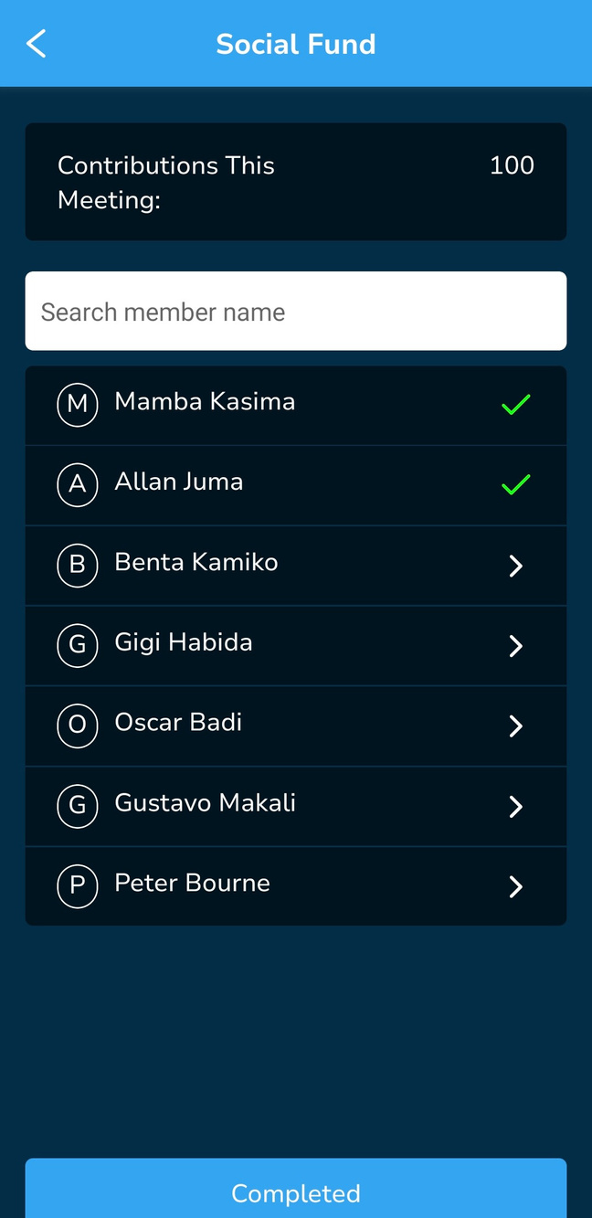
Social Fund Activities: member Contribution
KALORITY
For every member whose Social Fund contribution and details are saved, a green checkmark is shown beside their name.
The individual member contributions in the meeting will be summed and displayed as the value for ‘Contributions This Meeting’.

Slide 32
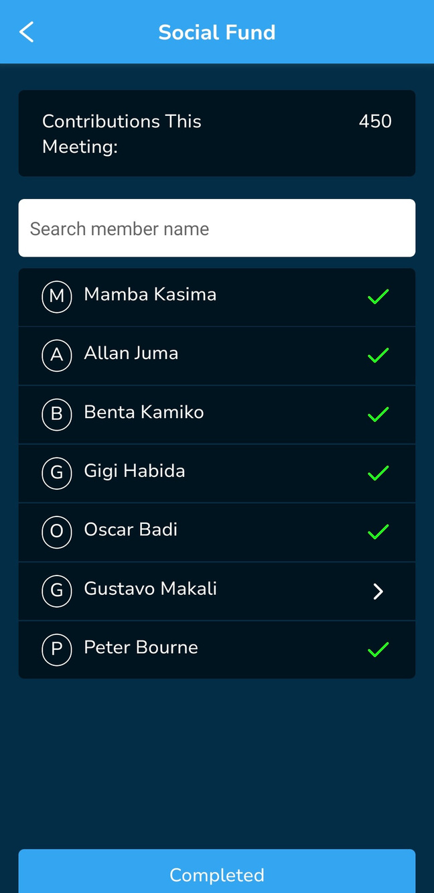

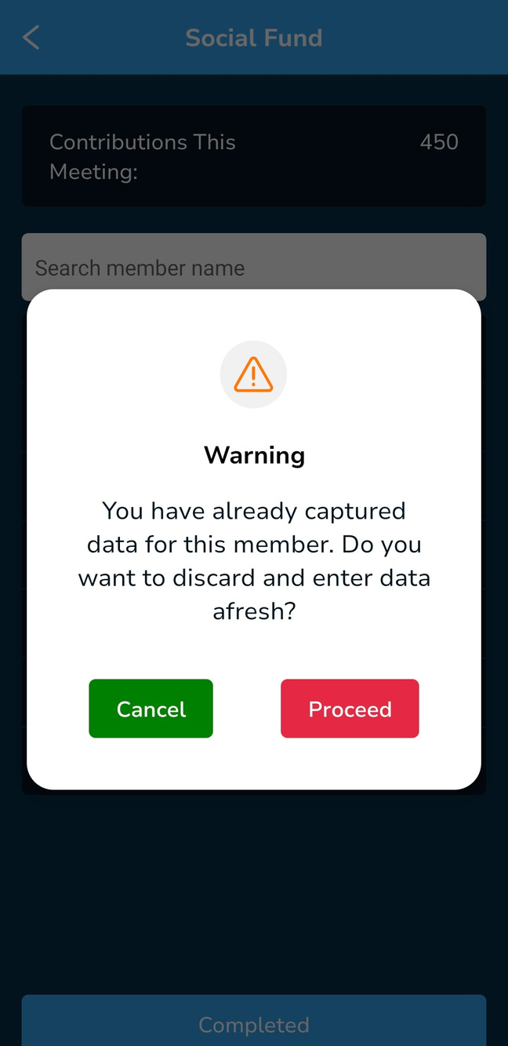
Social Fund Activities: Overwrite member Contribution
KALORITY
If a mistake is made when recording an individuals member contribution or when they want to change their contribution, then clicking on the member will remove the previous contribution and a new contribution can be input.

Slide 33
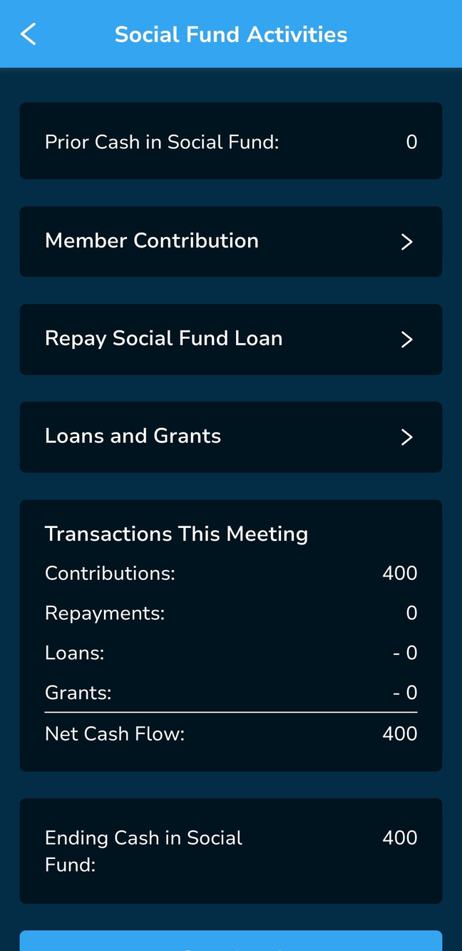
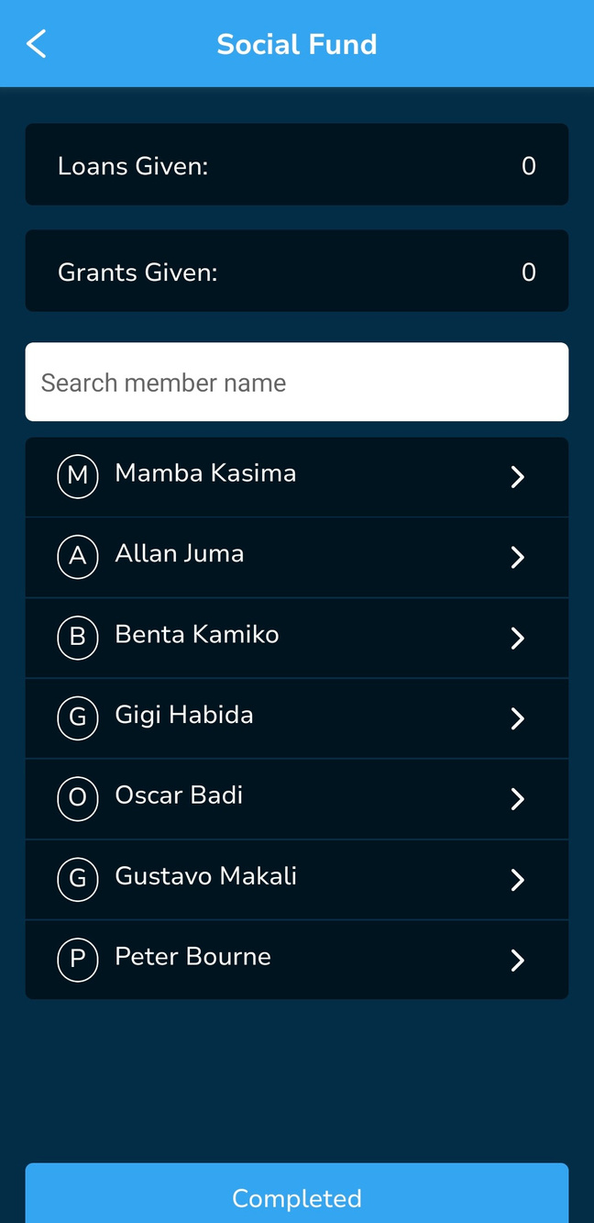
KALORITY
Social Fund Activities: Loans and Grants
A Social Fund Loan is given to a member when requested and must be paid back as defined by the group. On the app, this loan does not accrue interest.
A Social Fund Grant is given to a member when requested and is not paid back.

Slide 34
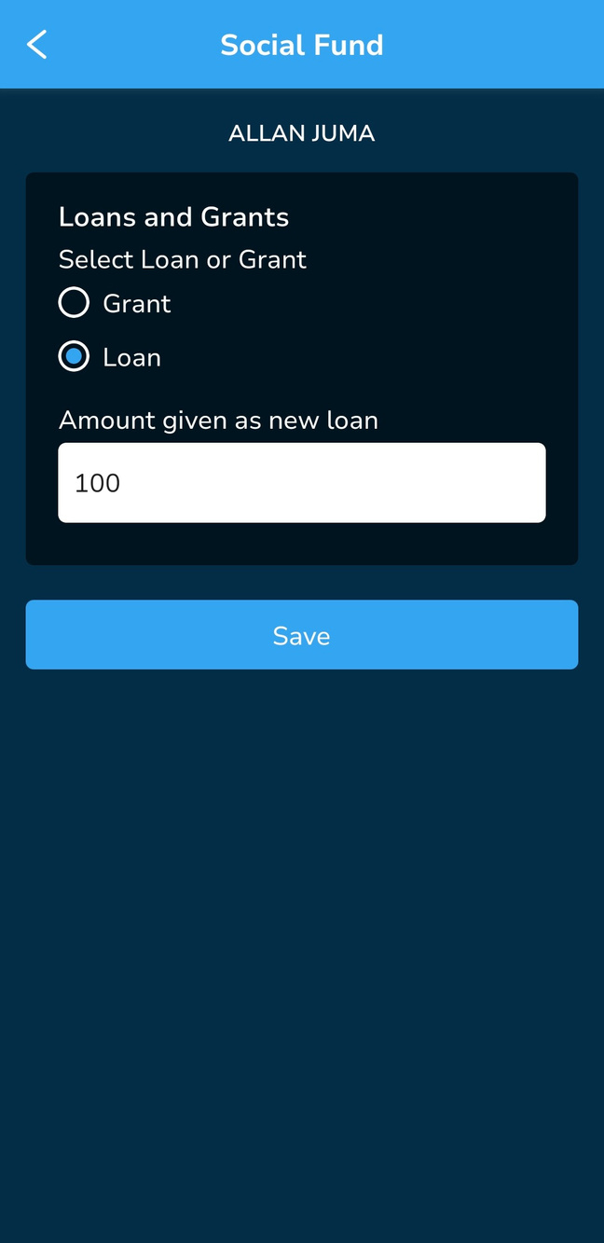
KALORITY
Social Fund Activities: Loan
The member to be given a loan or grant is selected from the list.
Then the record keeper must select between a grant or a loan, and specify the amount before clicking ‘Save’

Slide 35
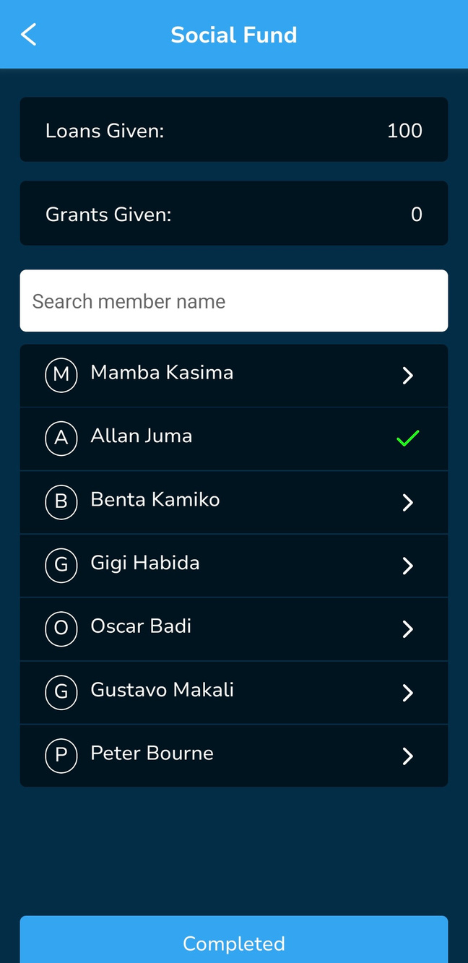
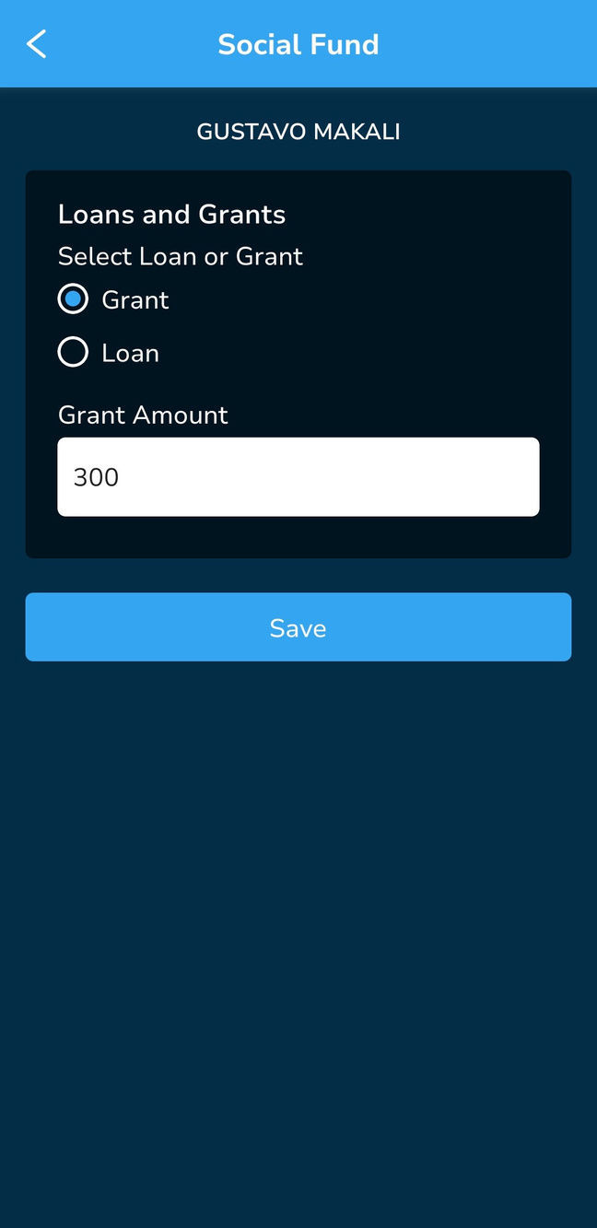
KALORITY
Social Fund Activities: Grant
The member to be given a loan or grant is selected from the list.
Then the record keeper must select between a grant or a loan, and specify the amount before clicking ‘Save’

Slide 36
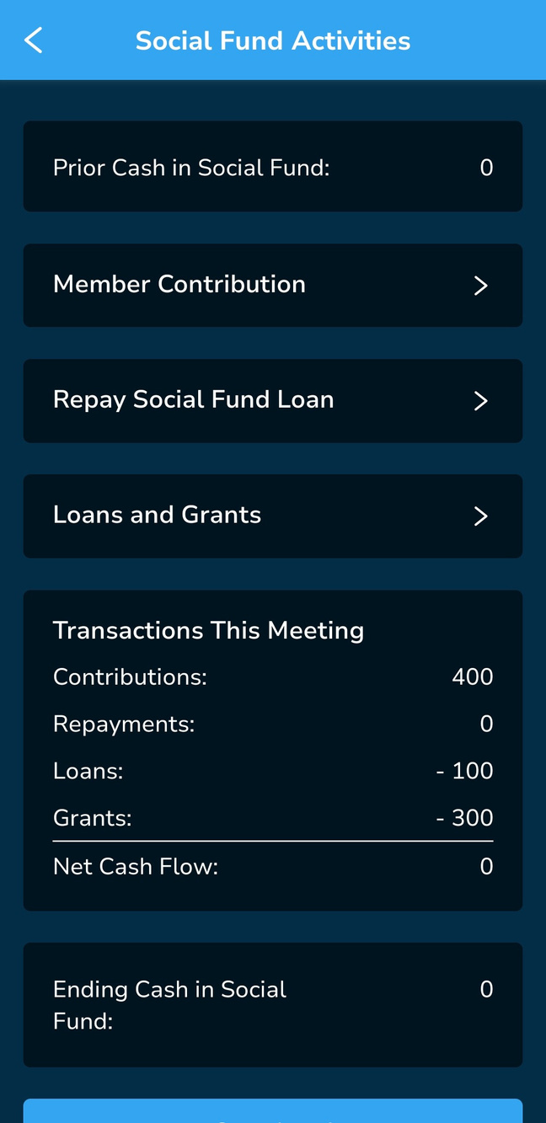

KALORITY
Social Fund Activities: Repay Social Fund Loan
Any member with a Social Fund loan will appear on this list.

Slide 37

KALORITY
Social Fund Activities: Repay Social Fund Loan
To repay loan, click on the member making a repayment, then record the value of their repayment and click save.

Slide 38

KALORITY
Social Fund Activities: Repay Social Fund Loan
Once the repayment is saved, the member’s name gets a green checkmark beside it.
Once all loan repayments are complete, the data saved by clicking ‘Complete’ which takes you back to the Social Fund Activities Screen.

Slide 39
KALORITY
Social Fund Activities: Complete
When all the Social Fund Activities are done, Click the button ‘Complete’ to save the data on the app.

Slide 40

Meeting Steps: After Social Fund Activities
KALORITY
‘Is this a shareout meeting’ - This checkmark should only be selected if the group has come to the end of their cycle and are ready to distribute either part or all of the money accrued during the cycle. Most if not all loans should be cleared prior to the meeting .
Cash Balances at the start of meeting -These fields are populated from the previous cash balances recorded. They are displayed here for the group to recheck their balances through a physical count of cash.
Social Fund - Social fund records (contributions, loans, grants and loan repayments).
Savings per member - Savings deposited or Shares bought during the meeting are recorded for each member
Loan Repayments per member - Loan repayments made during the meeting are recorded here.

Slide 41

Meeting Steps
KALORITY
Loan Disbursement per member - Loans disbursed during the meeting are recorded here.
Enter Cash Balances at end of meeting - Once all the net cash at the end of the meeting is counted, it is recorded in these fields. These are the source of starting cash balances data when you start the next meeting.
Save Data & Close Meeting - Once all the data has been recorded, the meeting will be saved and closed with the click of that button. It cannot be edited after that.

Slide 42


KALORITY
Meeting Steps: No Social Fund or Bank Account
This displays a screen for a group that has no Socila Fund of bank account, therefore only showing Loan Fund cash
Prior cash in Loan Fund -This field is calculated by the app so it is important for a group to counter check this amount against what they have at the start of the meeting.
Savings Per Member - Savings deposited or Shares bought during the meeting are recorded for each member
Loan Repayments per member - Loan repayments made during the meeting are recorded here.
Loan disbursement per member - Loans disbursed during the meeting are recorded here.
Enter Cash Balances at end of meeting: Cash in Loan Fund is shown recorded here after all the net cash is counted at the end of the meeting. There are no other cash balances recorded.
Save Data and Close Meeting - Once all the data has been recorded, the meeting will be saved and closed. It cannot be edited after that.

Slide 43


KALORITY
Savings per member: Cash
STEP 1: select the member you wish to record savings for.
STEP 2: Enter cash savings equal to zero or above. Enter zero or above for withdrawals. Click save.
NB: You cannot withdraw from an empty account.

Slide 44


KALORITY
Savings per member: Cash
The application will show a green checkmark for every member whose savings have been recorded.
If you select a member with a green checkmark, you get the option to overwrite the existing data or leaving it as it is.

Slide 45


KALORITY
Savings per member: History
For each member, savings transactions are recorded and can be viewed when the ‘Show History’ button is clicked.
The history will have up to 5 recent transactions, meaning every new transaction will replace an older one leaving only 5 records. The purpose of retaining this record is to resolve potential disputes. . By limiting the records to the previous 5 meetings, this reduces the data load on the ‘phone.

Slide 46

Savings per member: Shares
KALORITY
STEP 1: select the member you wish to record savings for.
STEP 2: Enter share amount equal to zero or above. Enter zero or above for withdrawals.
NB: You cannot withdraw from an empty account.

Slide 47
Savings per member: Shares
KALORITY
The application will show a green checkmark for every member whose savings have been recorded.
If you select a member with a green checkmark, you get the option to overwrite the existing data or leaving it as it is.

Slide 48


Loan Repayments
KALORITY
Only members with loans will show on this list.
Select the member you wish to record payment for.
Total Owing: Is the balance since the last meeting
Due Date: when the loan was set to be completed after disbursement
Amount paid in cash: payment made by member in this meeting
New Service Charge: recalculated based on interest calculation method (this will be zero if less than 28 days have passed since the last service charge
New Total Owing: (total owing - cash payment) +

Slide 49


Loan Repayments
KALORITY
Loans are recorded for each member one at a time, and the application will show a green checkmark for every member who has made a loan repayment in the meeting. Please note: the list will show only members with loans.
If you select a member with a green checkmark, you get a pop-up option to overwrite the existing data or leaving it as it is.

Slide 50


Loan Repayments: History
KALORITY
Every repayment made by an individual member is recorded and can be viewed when one clicks the ‘Show History’ button.
The list will only show up to 5 transactions, meaning a new transaction will overwrite an older one leaving only 5 records.

Slide 51

Loan Repayments: WriteOff Loan
KALORITY
A loan can be written off from the repayment screen.
For the write off to go through, the app requires any two pins to authorise.

Slide 52


Loan Disbursement
KALORITY
STEP 1: Enter amount available for disbursement during the meeting and then proceed to the disbursement screen
STEP 2: Select the member to disburse a loan to. Please note, if a member already has a loan, they will not appear on this list, since it is assumed that a member can only have one loan at a time.

Slide 53


Loan Disbursement
KALORITY
Enter amount to be given as loan and the length of loan term in months (4 weeks/month)
Due date is calculated automatically based on the loan term

Slide 54


Loan Disbursement: Fixed Amount
KALORITY
For a loan with a fixed amount interest charge, the field ‘Service Charge’ is entered by the record keeper after the group agrees on the amount.

Slide 55


Loan Disbursement
KALORITY
Members who get a loan are marked using a green checkmark, selecting one such member will lead to the pop up shown. Proceeding clears the loan and starts over while clicking ‘Cancel’ retains the loan as is.
A member who had cleared their loan in the same meeting, will appear on this list, making them eligible for a new loan.

Slide 56


KALORITY
Loan Disbursement: Savings to Loan Ratio Exceeded
This happens when the group has set the ‘Savings to Loan Ratio’ configuration to ‘Yes’. The app will check the value of the loan to be disbursed against the member savings to determine the ratio. If it surpasses what was defined then the pop will appear. At that point the group should discuss and agree on whether to bypass the rule (possible in case of urgent need) by clicking ‘Proceed’ to disburse or ‘Cancel’ to stop disbursement.

Slide 57

Backup
KALORITY
Once a meeting has been recorded and saved, it is recommended that the group backs up its data. It does this by clicking on ‘Backup & Restore’ on the main menu and choosing the correct option on the following screen

Slide 58


Backup
KALORITY
The user confirms that they wish to back up data and selects the name of the group email account configured on the phone. This is where the backup will be restored.

Slide 59


Backup
KALORITY
Backup will then automatically complete.

Slide 60

Restore
KALORITY
This is useful to a group when they have lost their phone or damaged it , they can restore their group to a new device. They should ensure to:
Set up the same group email on the new phone. This is where the backup will be downloaded from.
Register the group on the new device.
Navigate to Backup & Restore once they are logged in, and click ‘Restore’

Slide 61

Reports: Group Information
KALORITY
This report shows Group Configurations
Group Name
Date group was enrolled on the application.
Current cycle
Number of members
Interest Calculation method
Last Backup Date - the last time the complete meeting data and group configuration was uploaded to the group Google Drive account.

Slide 62


KALORITY
Reports: Group Financial Report
This report shows:
The number of meetings completed in the current cycle
Number of members at this time
Date report was generated.
Member savings and loan activity amounts
Cash balances based on the last meeting.

Slide 63

Reports: member Report
KALORITY
This report shows individual member savings and loan balancs.

Slide 64


Reports: member Report
KALORITY
This report shows individual member savings and loan balances and due date for completion of loan reimbursement that can be sent by SMS. In addition it includes a dated transaction record of all savings and loan activity for the member, which is not sent by SMS
The group phone should have a simcard . Standard rates apply based on the network provider in use.

Slide 65

KALORITY
Reports: member Report: Missing Phone Number
If the member’s phone number is not configured, then sending a report will not be possible until it is added in the member management screen.

Slide 66

KALORITY
Reports: member Report: Transaction History
Transactions History
Note: The app provides the history of transactions from the LAST 5 Meetings
This section outlines member transactions that add up to the balances shown in the first section.
Savings section shows the deposits and withdrawals done by the member.
Loans section shows breakdown of loan disbursement, interest applied, write-offs and repayments.

Slide 67


Reports: Shareout Report
KALORITY
When a group completes its loans and savings cycle, the last meeting of the cycle is a shareout meeting. The user selects ‘Is this a share-out meeting’
The record keeper then records any savings and loan repayments, updates the cash balances during the meeting, then clicks on the blue ‘Save & Share out’ button.

Slide 68



Reports: Shareout Report
KALORITY
The amount to be shared out is agreed and entered in the ‘Amount to be shared out field’
The amount received by each member out is based on a ratio of the savings of each member, with the result rounded down based on the smallest unit of commonly available currency and residual cash is shown. This report is available throughout the new cycle until another share-out is done.
Any outstanding loans will be listed as balances after first deduction of a member’s savings

Slide 69

KALORITY

